Slide 1
Verifying Correctness of a Chez Scheme compiler pass
Master’s Thesis Presentation by Ian Atol

Slide 2
Outline
Introduction
Background
Definitions
Proof
Validation Frameworks
Conclusion / Future Work

Slide 3
Introduction
Why care about compiler correctness?
Why is proving compiler correctness difficult?
Project overview
Notes:
Before we get into specfiics about the Chez Scheme compiler, our proof, and other details... first we should think about why we care about compiler correctness?

Slide 4
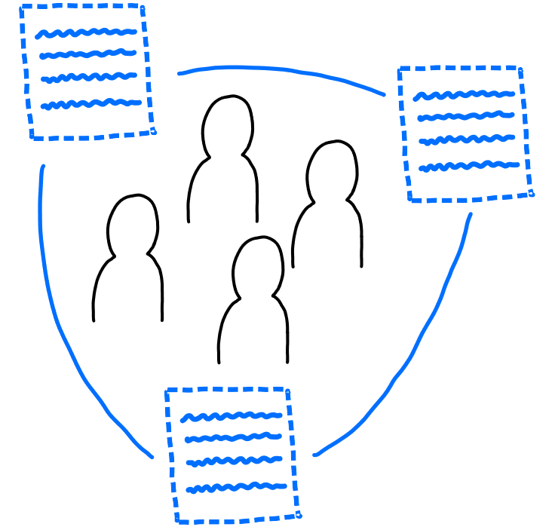
Software is all around us - ubiquitous
Notes:
As computer scientists, we already know this, but software is already present nearly everywhere in our lives
We’re on Zoom right now, phones in our pocket, air conditioning, etc

Slide 5
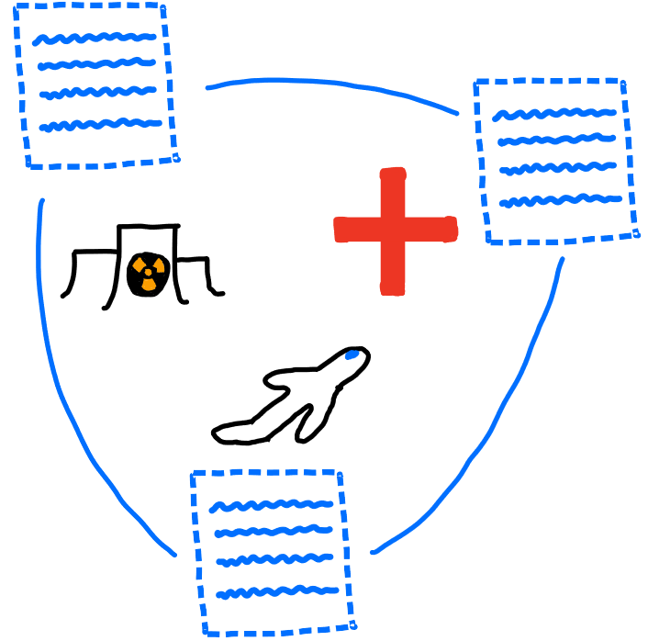
Software ubiquity means software significance
Notes:
Everywhere means everywhere - including in safety critical settings like airplanes, medical equipment, and nuclear reactors.

Slide 6

Software is imperfect
In 2011, 24% of medical device recalls were due to faulty software, and this number is increasing because of increasing complexity of devices
Notes:
We can observe this situation in many areas - complexity is increasing across the board
Needless to say, software errors in equipment thats controlling your heart or at the local nuclear power plant are very bad
So, can we fix?

Slide 7
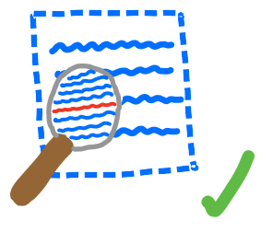
One approach to errors – Static Analysis
Notes:
In general, static analysis is the process of examining source code.
By carefully analyzing source code, we can devise proofs that certain kinds of errors don’t occur
Some analysis can be performed completely based on the syntax of a program – for ex, every line ending in a semi-colon.
However, for more complex proofs, we give meaning to the source code using the semantics of its language, for ex to prove a program results in a certain value

Slide 8
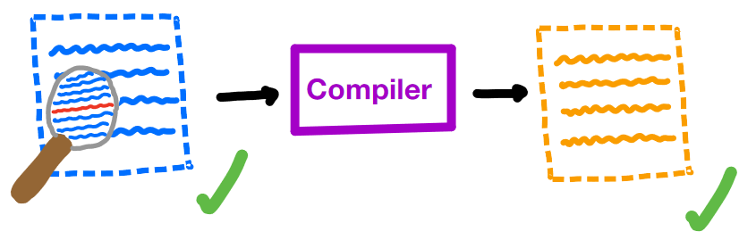
A critical assumption
Notes:
However, these proofs involving the semantics tend to make a critical assumption
We assume that our proof about a program holds for its compiled version - essentially we are trusting that our compiler didn’t make an error
For most cases, this is fine - mainstream compilers are pretty trustworthy, and most use cases aren’t critical
But if you have a pacemaker, for example, this assumption means trusting the compiler with your life

Slide 9
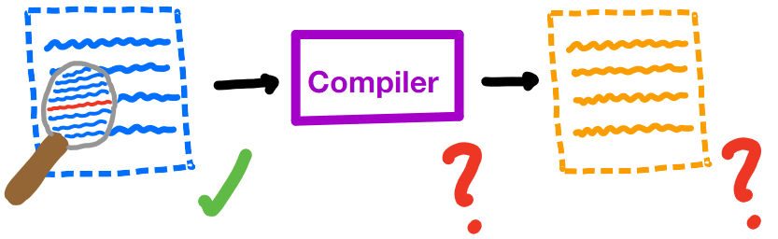
Minimizing assumptions
Notes:
In safety critical software, we want to minimize the assumptions we make.
Therefore, we are no longer assured that our compiled program is error free

Slide 10
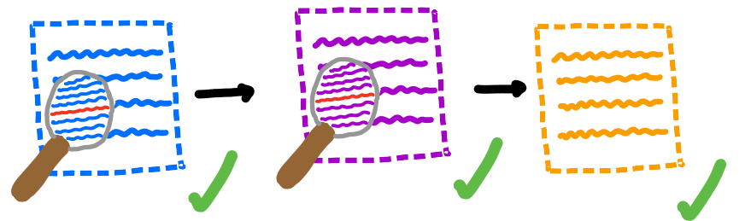
Trust, but verify (our compilers)
Notes:
Compilers are really just programs themselves, so we can apply static analysis to them as well
Specifically, we want to prove that our compilers translate correctly - that they preserve the semantics of programs that they compile
If we can prove correctness of our compilers, we can successfully remove an assumption and get closer to full trust of our software

Slide 11
Why aren’t all our compilers proven correct?
Compilers are big
Multiple languages involved
Consider ALL possible programs
Notes:
gcc ~15M lines of code
Compilers typically translate a program in a high level language to a program in a low level language. So we have to create a relationship between the semantics of these languages
Finally, to prove compiler correctness, we have to consider all possible programs in a language. Even for small languages, this can involve concepts that are difficult to reason about like recursion, mutation, etc.

Slide 12
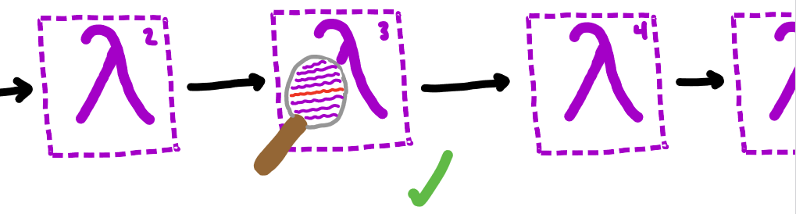
This project
Notes:
In this project, we give a proof of correctness of a single pass of the Chez Scheme compiler over a subset of Scheme
In this way, we simplify each of the problem areas:
Looking at a small part of the compiler
This pass translates from Scheme to Scheme so we can use the same semantics
We also cut out some of the language to reduce complexity

Slide 13

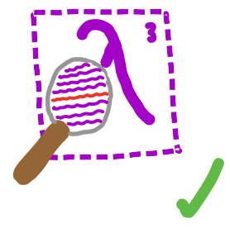

This project
Notes:
We also give two frameworks for validating our proof
The first, in Coq, was originally intended to be a complete mechanization of the proof.
While that ended up being outside of the scope of this work, we still provide an implementation of part of Scheme’s semantics and prove some basic properties about it
The second, in Racket, provides a way to show correctness of the pass (and our proof approach) for individual examples

Slide 14
Background
Compiler Correctness
Scheme

Slide 15
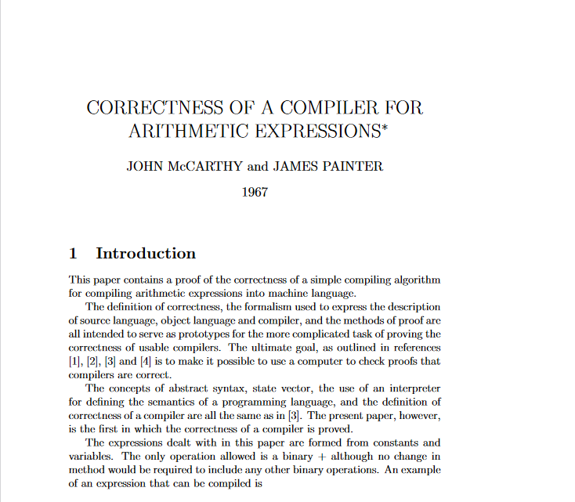
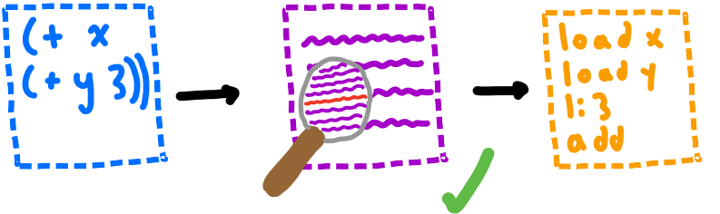
McCarthy, Painter 1967
Notes:
The first proof of compiler correctness comes from John McCarthy and James Painter
They provide a correctness proof for a simple compiler from arithmetic expressions to machine code
Their proof is intentionally simple, as they intended to create a framework for proving correctness of larger compilers

Slide 16
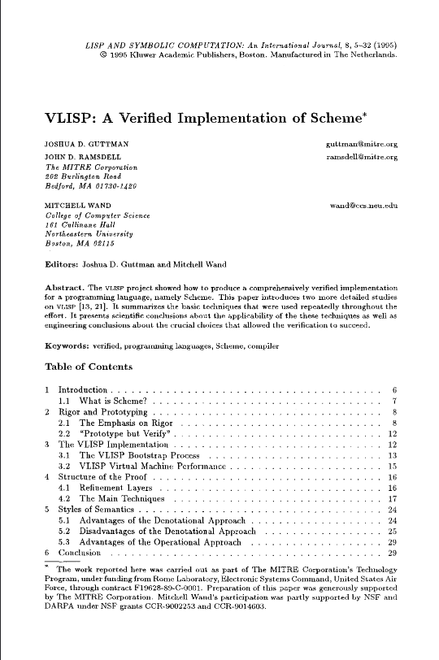

VLISP 1995
Notes:
VLISP is a proof of compiler correctness for an early version of Scheme
Also defines an operational semantics and translates between the operations and denotational semantics
Uses similar techniques to McCarthy’s proof in the operational parts

Slide 17
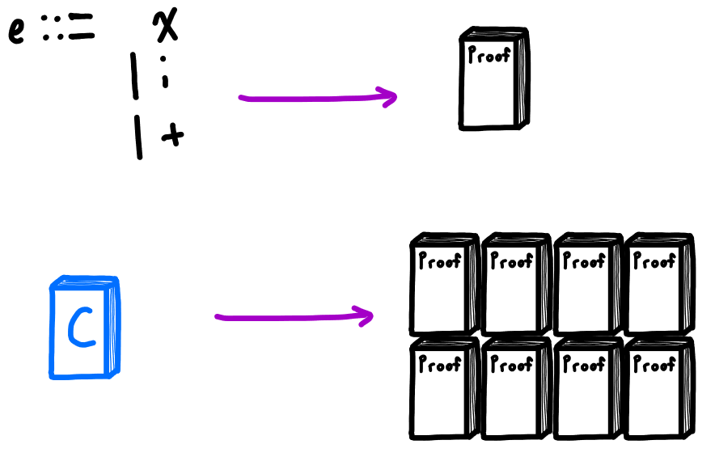
Correctness Proofs are Complex!
Notes:
McCarthy’s proof was about a tiny language of only 3 expressions, but still about 10 pages long
To reason about larger, practical languages, a proof would be very large. Still possible on paper, but checking such a proof by hand is difficult
Solution: use computers to help check

Slide 18
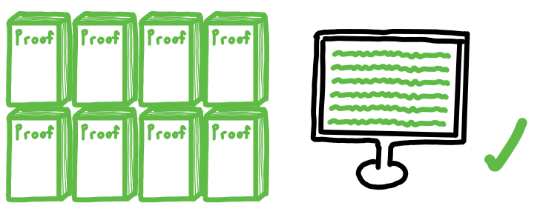
Solution: Mechanization
Notes:
Computers work perfectly and tirelessly – if we could get them to check our proofs, we would have a much higher degree of trust in their validity

Slide 19
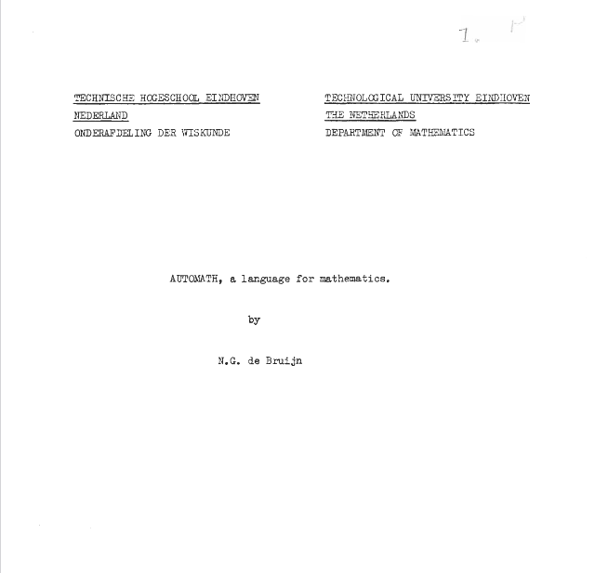
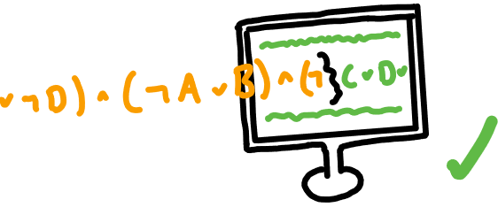
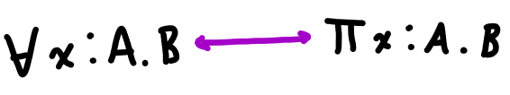
de Bruijn 1968
Notes:
In 1968, de Bruijn released Automath, a system for encoding and checking mathematical theories computationally
Automath does this by exploiting the Curry-Howard correspondence between intuitionistic logic and dependent types
So in Automath, theorems are defined as types, and proofs consist of showing that these types are inhabited by some value
Which means that proofs of theorems are just programs like any other, except that they directly correspond to statements in an intuitionistic logic

Slide 20
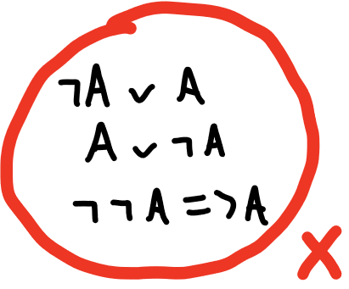

More on Automath and Intuitionistic Logic
Notes:
Automath works by exploiting a correspondence between intuitionistic logic and dependent types
But what is intuitionistic logic? Alternative to classical logic that requires direct proof – no indirect proofs because the law of the excluded middle is not assumed
Constructive because of this requirement of directness – if you want to prove something exists, you must build it directly
For example, a proof that given an integer, a greater integer exists would actually build and give back the greater integer

Slide 21
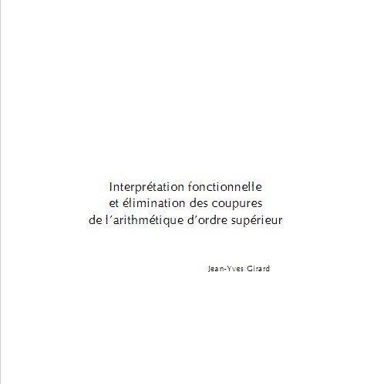
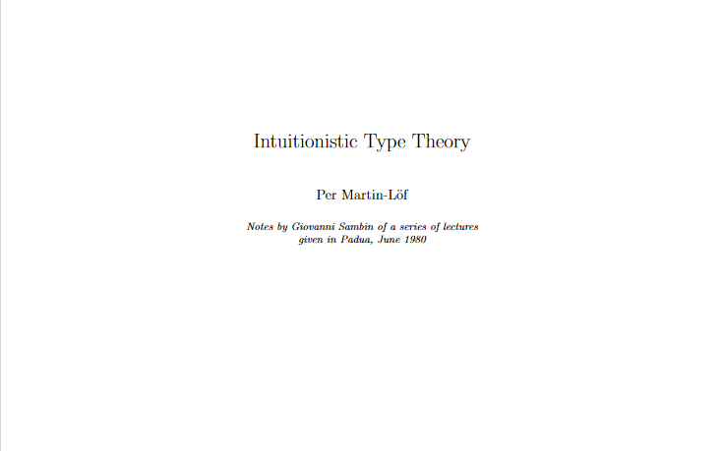
Girard 1972, Martin-Lӧf ~1980
Notes:
Martin-Lof and Girard advanced this connection by developing dependent type theories that were more expressive
Girard’s System F is quite similar to the type theory used by Automath, but should be mentioned for being important and famous in its own right
Martin-Lof’s Intuitionistic Type Theory is a full fledged dependent type theory, that was intended to serve as a computational foundation for mathematics

Slide 22
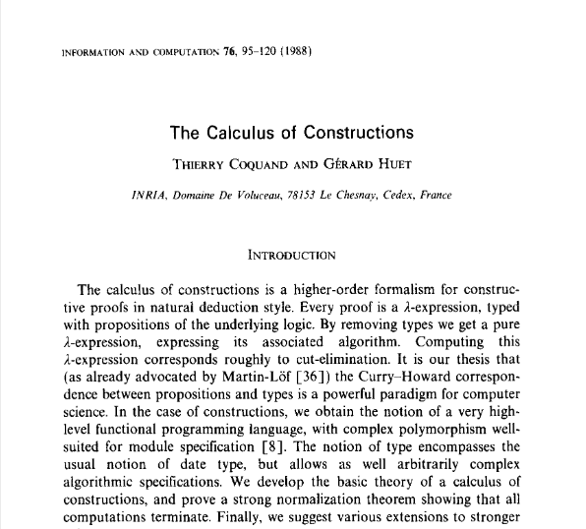
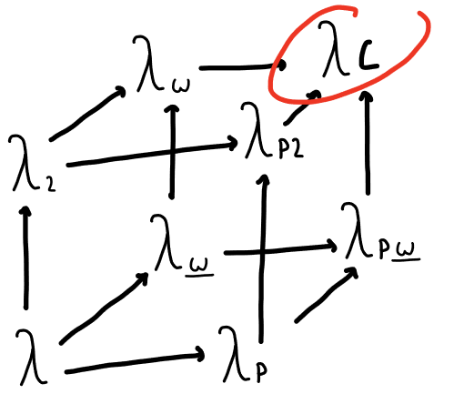
Coquand 1988
Notes:
Coquand developed the Calculus of Constructions, which combined intuitionistic type theory and system F.
Types and terms can depend on types and terms

Slide 23

Coq ~1980s
Notes:
Coq is a proof assistant based on Calculus of Constructions
Because of its specification and automation features, it has been used for some of the largest formal verification projects.
Two famous examples are the CompCert verified C compiler and a mechanized proof of the four color theorem, which had not been proven before.
Both of these proofs would be too large to accurately review by hand, but are believed to be correct with a high degree of trust because of their verification in Coq.

Slide 24
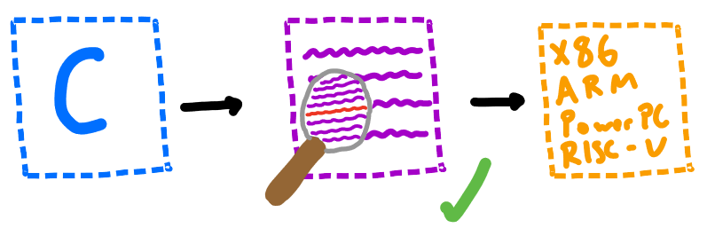
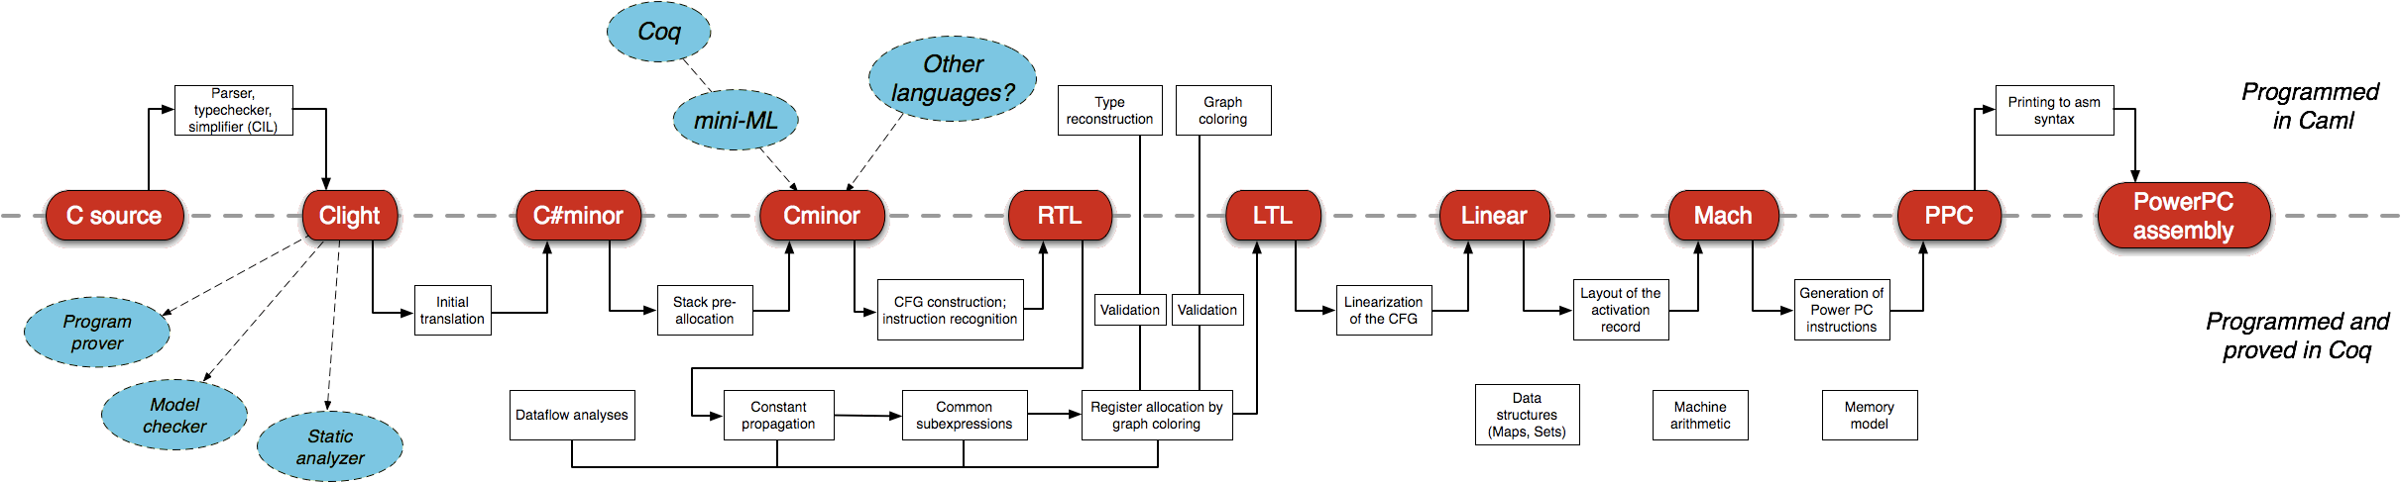
CompCert 2009
Notes:
CompCert is a verified compiler for a large subset of C
Written in Coq and OCaml, it is about 100,000 lines of code and took about 6 years to complete
Formally verifies semantic preservation of compiled programs
Suffice to say, it is very complex and quite a large project --- would be extremely hard to manually verify

Slide 25



Other Compiler Verification Projects
Notes:
There are a few other verified compilers projects that are worth mentioning
CakeML is a verified compiler for a subset of ML
CertiCoq is a verified compiler for Gallina, which is the Calclulus of Constructions implementing language that Coq uses
Finally, there have been various extensions to CompCert, such as extending it to a C subset that supports concurrency

Slide 26
Background
Compiler Correctness
Scheme

Slide 27
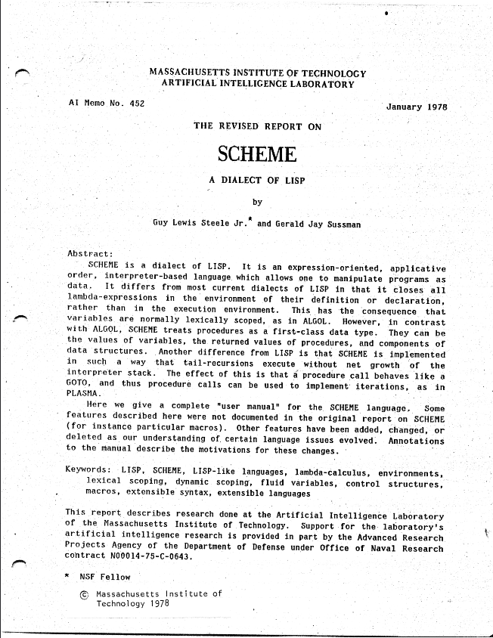

Scheme 1978
Notes:
Originally an attempt to build a LISP dialect for modeling actor-based concurrency,
While LISP supported lambda expressions, Steele and Sussman discovered they could greatly simplify LISP by following the semantics of the lambda calculus even more closely
This specifically meant using static scoping and call-by-value evaluation which more accurately follows the way the call-by-value lambda calculus works
Other important features include first class functions, homoiconity, and mutation. Though now it is also known for its macros, these were not in the original version

Slide 28
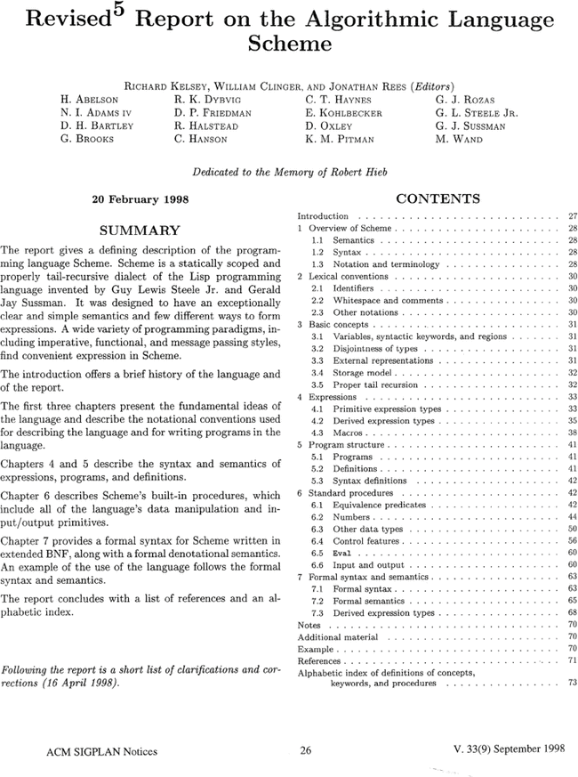
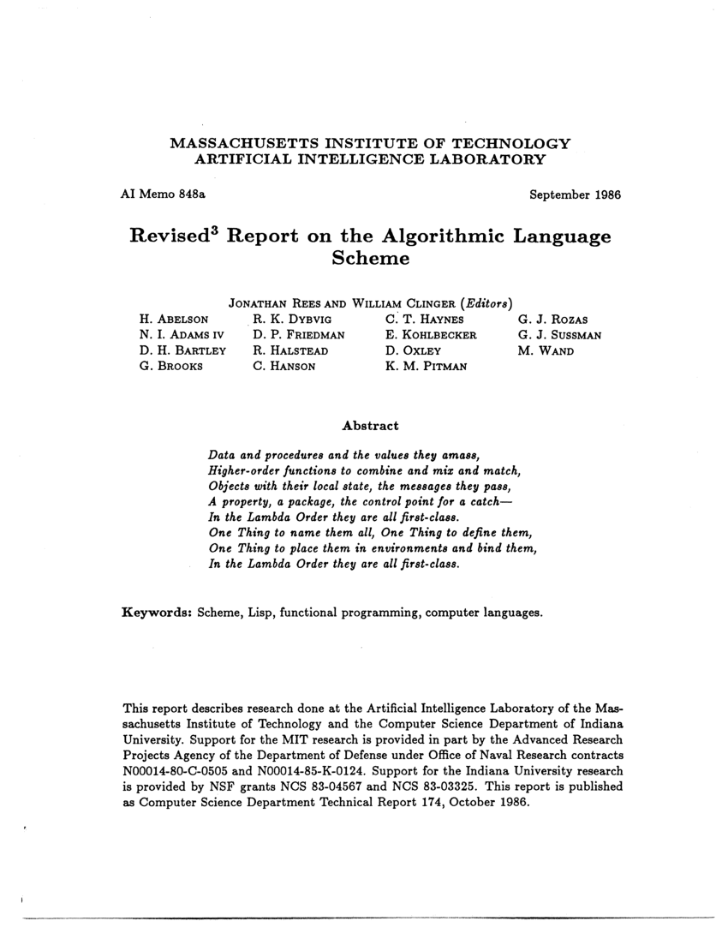
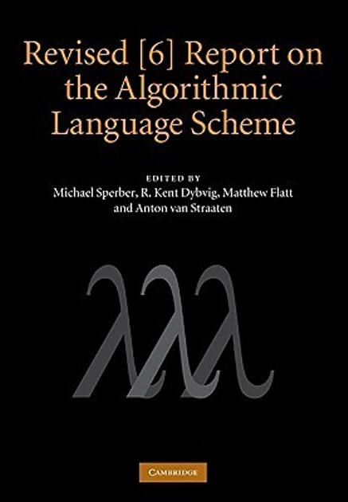
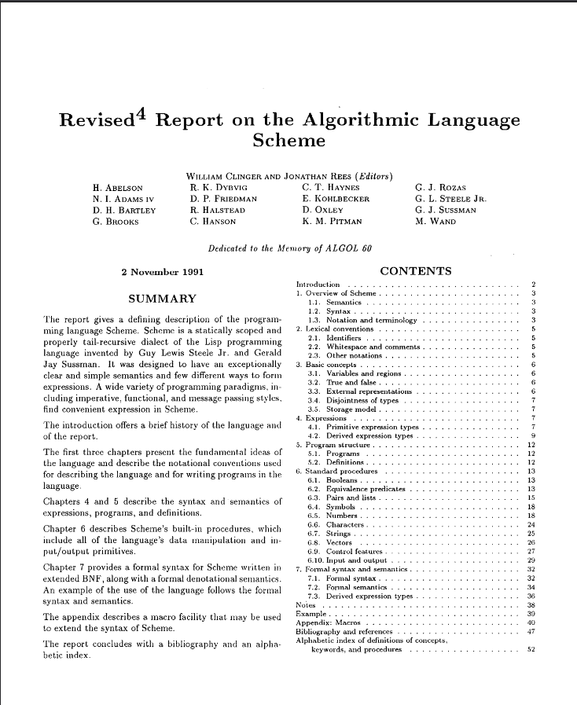
Scheme Language Standards
Notes:
Scheme has a standard in the form of the Revised n Report on the Algorithmic Language Scheme
Current version is R7RS, but we looked at R6RS because the compiler is based on that
R6RS includes a formal semantics for a subset of Scheme, as well as an implementation of the semantics, which we use for one of our validation frameworks

Slide 29
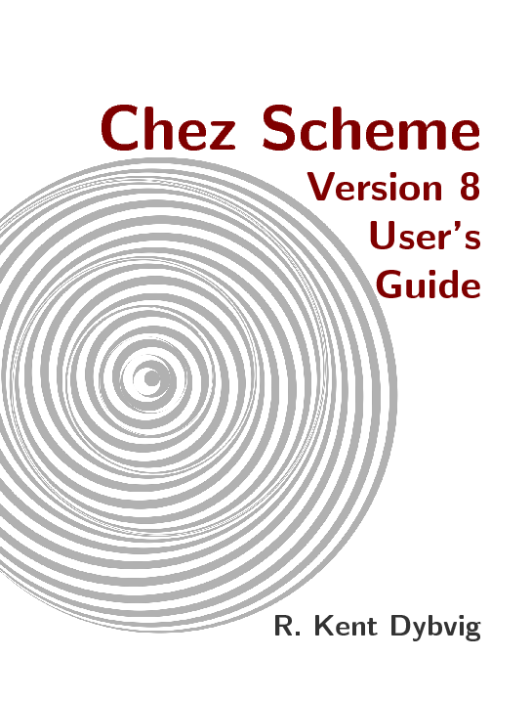

Chez Scheme
Notes:
Chez Scheme is an implementation of the R6RS standard, with an emphasis on performance
Also adds features like a C interface and concurrency
Bought by Cisco in 2011 and made open source in 2016

Slide 30
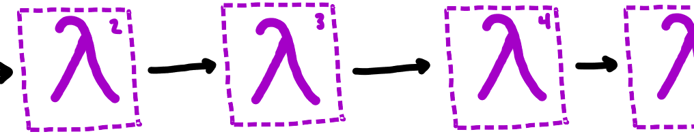
The Chez Scheme Compiler
Notes:
The compiler for Chez Scheme utilizes the Nanopass framework, also serves as the compiler for Racket
Nanopass is a DSL for easily defining intermediate languages and passes between them
Focused on very small changes from pass to pass

Slide 31
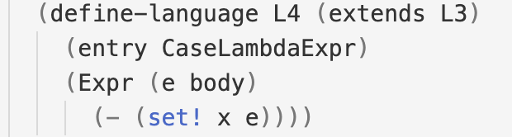
Nanopass Language Definition Example
Notes:
A quick example of a language definition
Takes the language L3 and removes set! Expressions
This is language corresponds to the pass that we are verifying

Slide 32
Outline
Introduction
Background
Definitions
Proof
Validation Frameworks
Conclusion / Future Work

Slide 33
Definitions
Syntax
Semantics
The convert-assignments pass

Slide 34
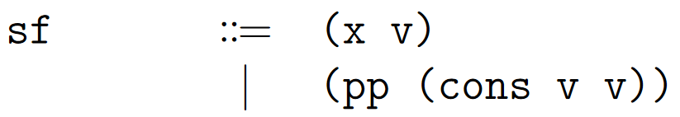
Syntax
Notes:
Our programs consist of a store with store locations and an expression
Store locations are either a variable and a value, or a pair pointer and a cons expression
Note that dots means zero or more, so the store can be empty too (think of Kleene star)

Slide 35
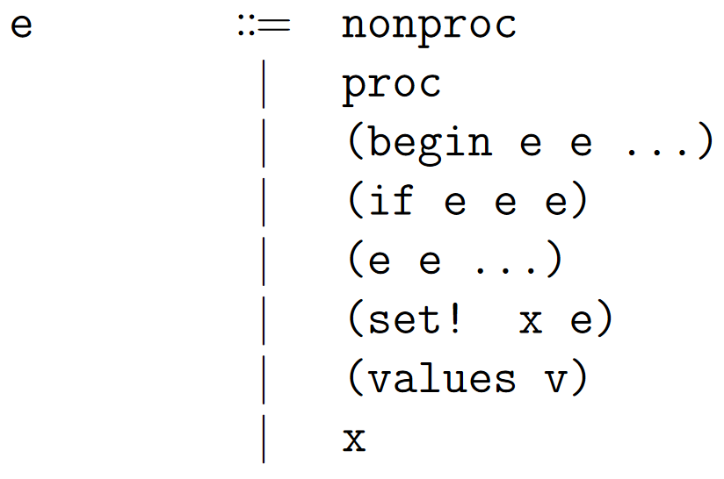
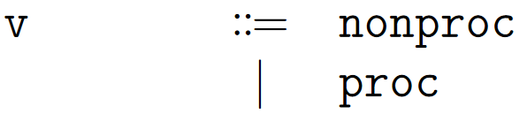
Syntax
Notes:
Expressions can be a procedure or non-procedure (more on that later)
Or a begin, if, application, set!, values expression, or a variable
We define values as all expressions that aren’t begin, if, application, etc.
Notice that values only takes one value --- more on this later

Slide 36
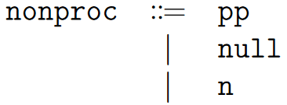
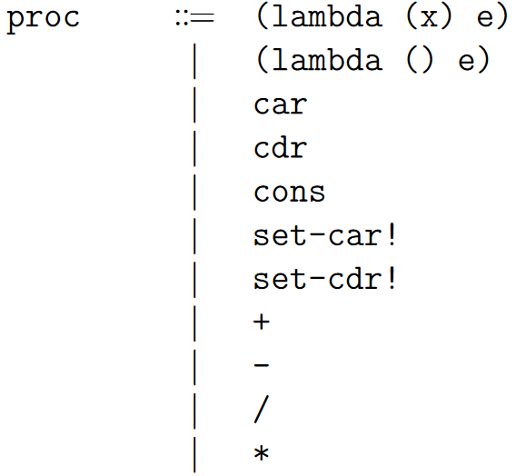
Syntax
Notes:
Nonproc is numbers, null, and pointers to store locations
Procedures are, well, procedures. Note we restrict lambda expressions to one or fewer arguments

Slide 37
Proof
Deterministic Semantics
ca is a simulation relation
ca is semantic preserving

Slide 38
Validation Frameworks
Coq
Racket

Slide 39
Outline
Introduction
Background
Formalizing Scheme
Proof
Validation Frameworks
Conclusion / Future Work

Slide 40
Bibliography
K. Sandler, L. Ohrstrom, L. Moy, and R. McVay, “Killed by code: Software transparency in implantable medical devices,” Software Freedom Law Center, pp. 308–319, 2010.
I. Lee et al., “High-confidence medical device software and systems,” Computer, vol. 39, no. 4, pp. 33–38, 2006, doi: 10.1109/MC.2006.127.
J. Mccarthy and J. Painter, “Correctness of a compiler for arithmetic expressions,” 1967, pp. 33–41.
N. G. de Bruijn, “A Survey of the Project Automath**Reprinted from: Seldin, J. P. and Hindley, J. R., eds., To H. B. Curry: Essays on Combinatory Logic, Lambda Calculus and Formalism, p. 579-606, by courtesy of Academic Press Inc., Orlando.,” in Selected Papers on Automath, vol. 133, R. P. Nederpelt, J. H. Geuvers, and R. C. de Vrijer, Eds. Elsevier, 1994, pp. 141–161. doi: 10.1016/S0049-237X(08)70203-9.
J.-Y. Girard, “Interprétation fonctionnelle et élimination des coupures de l’arithmétique d’ordre supérieur,” PhD Thesis, Éditeur inconnu, 1972.
P. Martin-Löf, “An intuitionistic theory of types,” Twenty-five years of constructive type theory, vol. 36, pp. 127–172, 1998.
T. Coquand and G. Huet, “The calculus of constructions,” PhD Thesis, INRIA, 1986.
X. Leroy, “Formal Verification of a Realistic Compiler,” Commun. ACM, vol. 52, no. 7, pp. 107–115, Jul. 2009, doi: 10.1145/1538788.1538814.
G. L. Steele Jr and G. J. Sussman, “The Revised Report on SCHEME: A Dialect of LISP.,” MASSACHUSETTS INST OF TECH CAMBRIDGE ARTIFICIAL IN℡LIGENCE LAB, 1978.

